Slide 1


Selection Of Sites
Presented By :- Manali, Mayuri, Aarti,vinay

Slide 2
Content
Site selection
Factors for selection
Interaction between the clinical trial sponsor/CRO
and study site
Conclusion
References

Slide 3

Site Selection
The site selection is crucial to the outcome of a clinical trial; it has the power to either make or break it.
A clearly defined evaluation criteria taken from the research design makes it easier to identify and compare suitable sites so that the best possible one is selected.
The geographical location and the local population are among the most important factors to consider when choosing a site.
Other factors revolve around the site staff, facility requirements, the study duration and target timelines.
Notes:
Site selection is a vital process in conducting clinical trails successfully, efficiently and in compliance with regulatory guidelines.

Slide 4

Factors For Selection
Staff Qualifications
Facilities and Equipment
Site Profile and Timelines
Population Profile and Access
Past Performance
Competition
Location
Notes:
Staff Qualifications
Take into consideration the staff availability, their credentials, their experience in clinical research and how their performance adheres to regulatory and ethical guidelines.
Facilities and Equipment
Does the facility have adequate space available for the clinical trial, drug and device storage space, storage of important documents and equipment needed for the study?
Site Profile and Timelines
What kind of site is it? (hospital, clinical, non-profit, government or private site), what is the site’s Institutional Review Board (IRB) meeting timeframe and contract negotiation timeline?
Population Profile and Access
Takes into consideration the eligible participants availability and proximity to the site, their condition, any similar ongoing trials, recruitment capabilities and the resources available for conducting research.
Past Performance
Look into the past clinical trials conducted at the site, especially trials that had similar enrollment timelines, enrollment targets and past enrollment rates.
Competition
Look at any current trials which target the same population profile. Are the trials taking place in close proximity to your site? (This would have an impact on participant recruitment).
Location
Is the site located in a central area that is easy for participants to get to? Is it close to amenities, including public transport, airports and hotels (for interstate and international participants)?

Slide 5
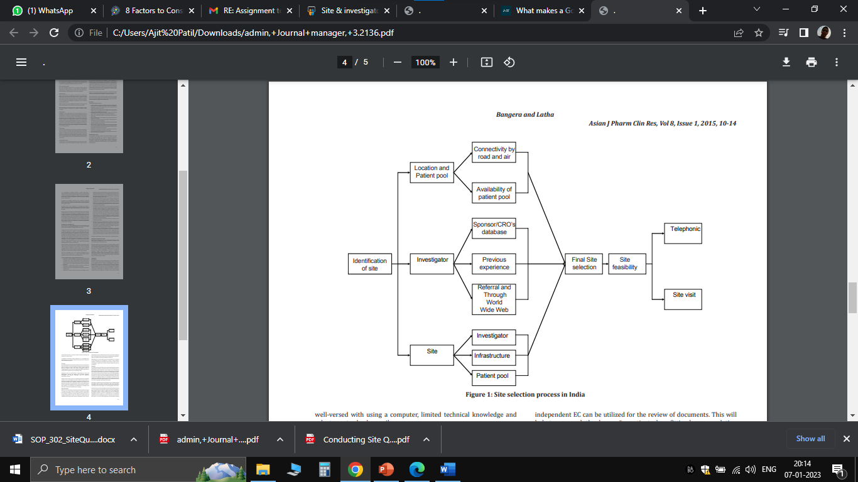
Site Selection Process In India

Slide 6
Important things to remember when selecting a site
An unbiased and systematic review of the site’s compatibility with the study needs to take place.
Proper site selection is not the sole factor for site performance and study success, although it does play a crucial role.
External forces can challenge study conduct (clinical trial design, protocol, difficult to meet inclusion/exclusion criteria, supply chain demands, cultural and technological considerations).

Slide 7
Process for selecting the right site (1/4)
Once a potential site has been identified, the Principal Investigator (PI) is sent an enquiry for clinical trial participation which includes a study synopsis to assess interest and request the site’s CV.
A successful site’s CV will include:
Evidence of Good Clinical Practice.
Staff member’s CVs, roles and experiences.
Training certificates for EDC (Electronical Data Capture).
Equipment calibration certificates.
IMP (Investigational Medicinal Product) temperature monitoring SOPs (Standard Operating Procedures)

Slide 8
Process for selecting the right site (2/4)
IMP (Investigational Medicinal Product) temperature monitoring SOPs (Standard Operating Procedures)
Details of the electronic system used for patient records.
Number of patients the site has access to.
Details of past performance - percentage recruitment to target, retention rate, First Patient, First Visit dates met (FPFV)
How long has the site been involved in trials and what phase trials are they experienced in conducting.
Audit findings.
Directions to the site and parking information.

Slide 9
Process for selecting the right site (3/4)
If the PI is interested, set up a Non-Disclosure Agreement (NDA)
Once the NDA is completed, the study protocol can be shared with the PI and a survey that addresses the pre-defined criteria can be provided to the site.
The questionnaire can be submitted to an online survey system which can allow results to be compared and can produce results that can be easily exported to a spreadsheet.
Discuss contracting and budgeting with admin staff early on in the process.
Notes:
(a contract where one or more parties agree not to disclose confidential information).
(CTAs (Clinical Trial Approvals) are sent to each site and documents can be prepared)

Slide 10
Process for selecting the right site (4/4)
Pre study visits (PSVs) and Site Selection Visits or Site Assessment Visits (SAVs) are conducted by Site Monitors.
A meeting is conducted to establish a relationship with the PI and site staff and to explain the study in more detail, including study objectives, overall design, procedures and endpoints.
After all the relevant information has been collected, reviewed, and evaluated an objective comparison and decisions can be made.
After a thorough evaluation, the final sites are notified of their selection for the trial.

Slide 11

Interaction between the clinical trial sponsor/ CRO and study site
Expect a Site Initiation Visit Before the Study: A representative from the sponsor company will go to the site and introduce key staff to the study, answer any questions and make sure they’re prepared for the upcoming trial.
Prepare for Visits by Monitors: Monitors (auditors from the sponsor company) regularly visit the various research sites employed by the sponsor to ensure that required processes are being followed.
Sponsor Support: The sponsor is there to guide the research site through the clinical trial. It’s their job to ensure that a site is well-informed. The sponsor is also the first person who should be informed about any legal, ethical or structural issues that may arise during the trial

Slide 12
Conclusion
Proper site selection is the key factor in determining timely completion of the study, without any major hurdles. Hence, many activities need to be performed and should be done with most care.
The site has to be evaluated continuously throughout the study since it is not a one-time activity performed at the time of site selection.
As problems may be expected to arise at any time during the study, which can delay its completion, continuous and vigilant evaluation of the site is absolutely necessary.
Sponsors have to dedicate a lot of time and effort on this aspect.
With proper training and supervision, many sites and institutions in towns and districts can be utilized.

Slide 13
References
Site Selection For Clinical Research In India, Sudhakar Bangera1, Latha Ms2 1program Director, Clinical Development Service Agency, Gurgaon, India. 2professor Of Pharmacology, Hyderabad, India.
ICH-GCP E6(R1) : Guideline For Good Clinical Practice
Notes:
A well-defined site selection and site management procedure is required to protect a company’s expenditure; successful completion of a study within a budget and timelines and to ensure high performance and competitiveness (not just getting high numbers of patients who do not comply with the protocol specified visits or high screen failures), meeting global and Indian regulations and guidelines generating high quality data.

Slide 14


